Slide 1
Annual Summary
Wang Kun
1/15/2016

Slide 2
1. Quantum Walk with Disorders

Slide 3
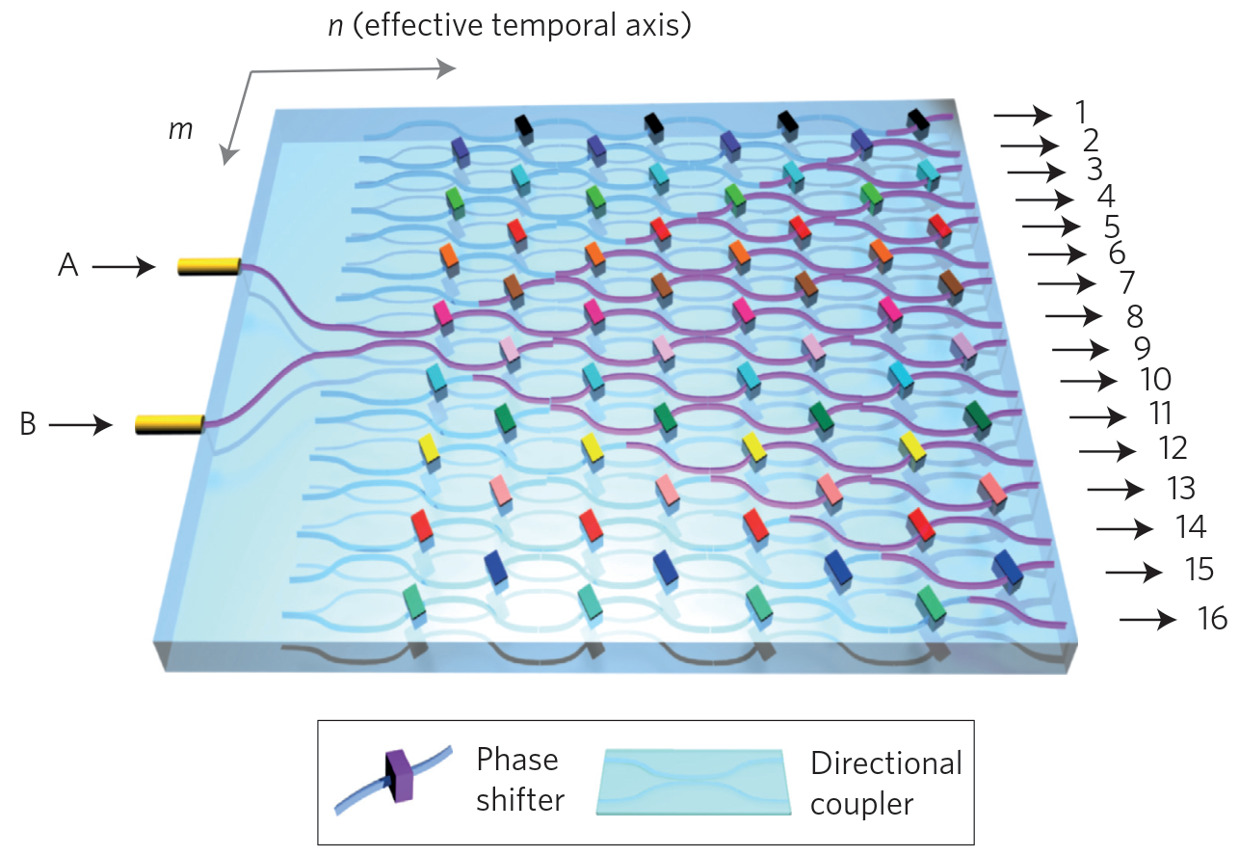
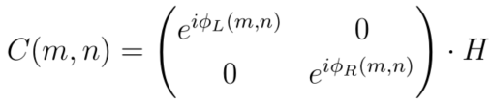
Discrete quantum walk with disorders
References:
10.1103/PhysRevLett.106.180403, 2011
10.1038/nphoton.2013.26, 2013
10.1103/PhysRevA.89.032322, 2014
Notes:
Keywords:
Optical networks.
H is the Hadamard gate.
Coin operators with disorder are still unitary.

Slide 4
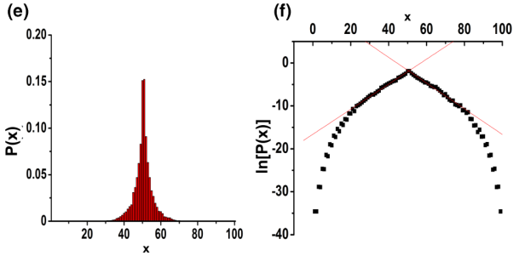
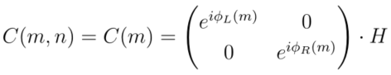
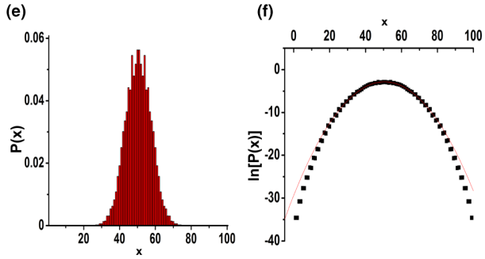
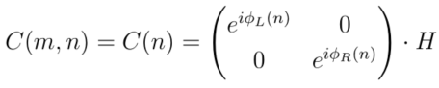
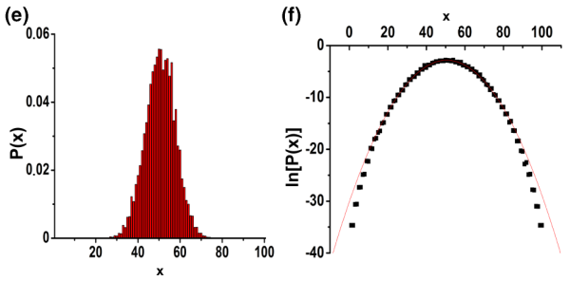
Classification of disorders
static (position-dependent)
Localization
dynamic
(time-dependent)
disorder
Decoherence
fluctuating
(both position and time dependent)
Decoherence
Notes:
Keywords:
In Anderson localization, probability is exponentially decay, thus Log(P(t)) is linear dependent in position.
In normal random walk, probability is not exponentially decay, Log(P(t)) is parabolic dependent in position.
Decoherence by unitary operations.
In the fluctuating model, dynamic disorders beat static disorder and result in decoherence.

Slide 5
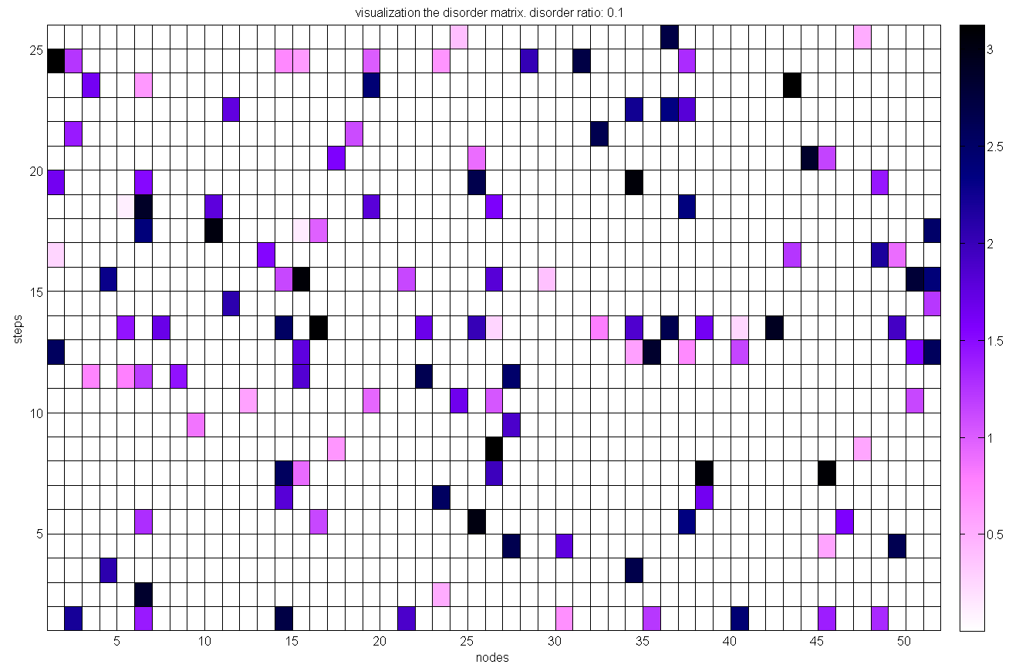
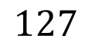
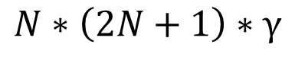
Fluctuating disorders visualization
Disorder ratio γ
Number of steps N
Number of disorders
$$N∗\left(2N+1\right)∗γ$$
Example
γ = 0.1
N = 25
Num of disorders
$$127$$
Notes:
Keywords:
Optical networks.
H is the Hadamard gate.
Coin operators with disorder are still unitary.

Slide 6
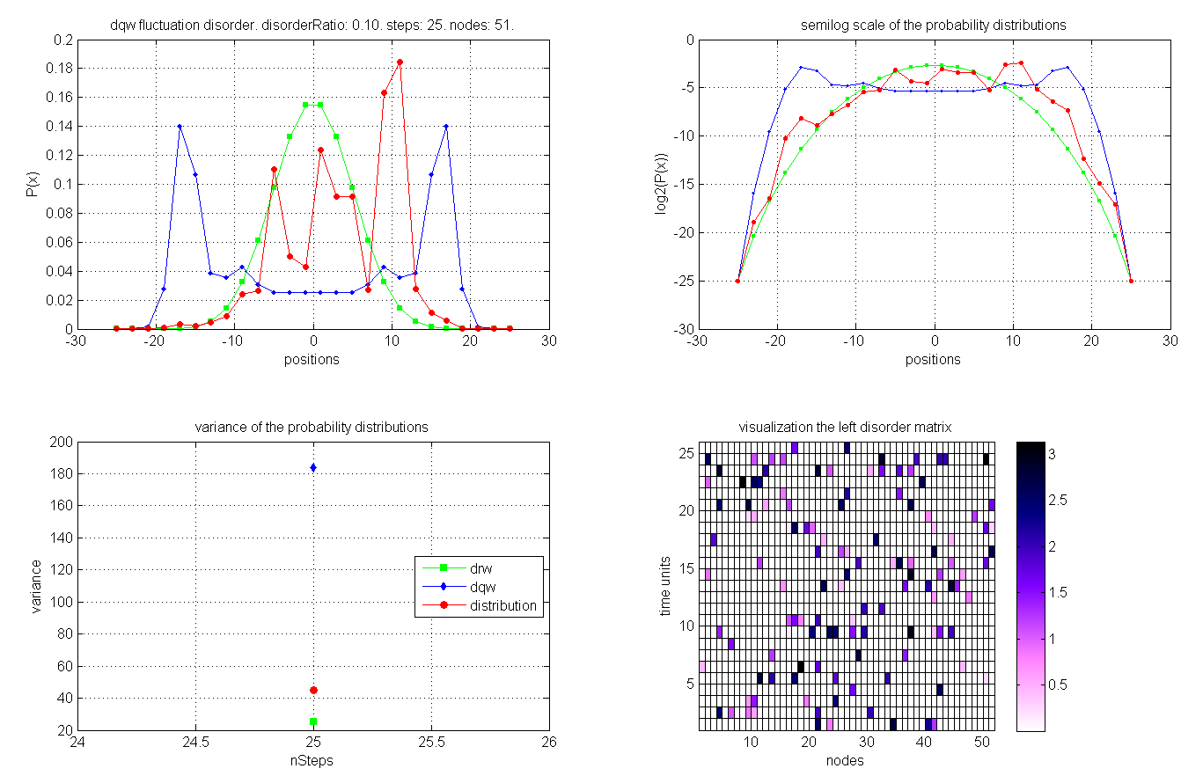
Disorder ratio = 0.1: an example

Slide 7
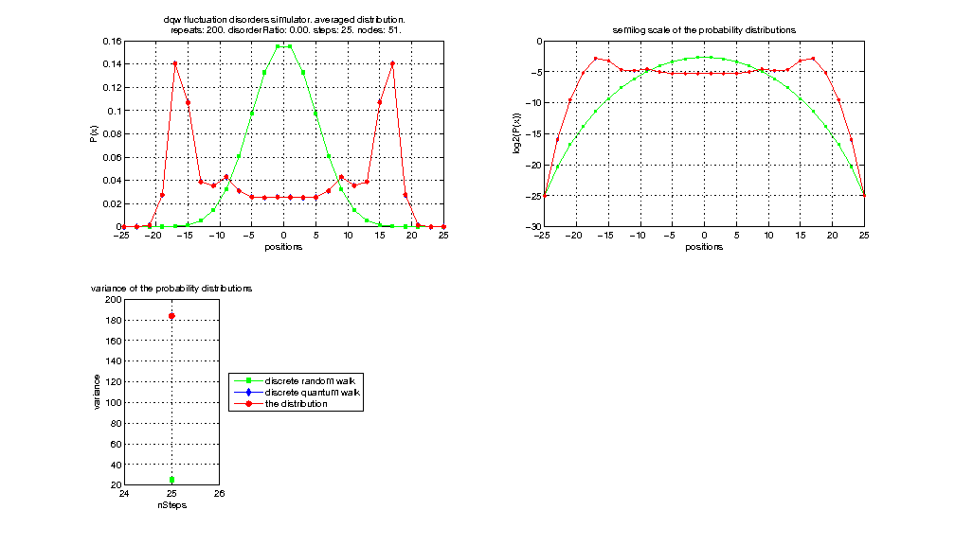
Disorders result in quantum walk to random walk
Decoherence introduced by disorders results in quantum walk to random walk gradually.
How fast?

Slide 8
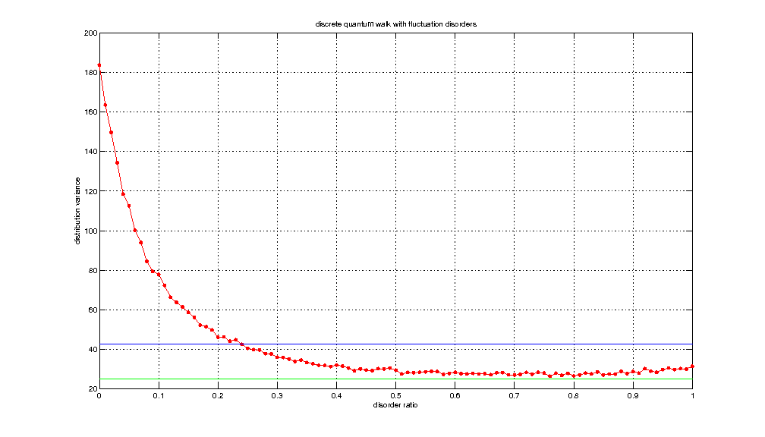
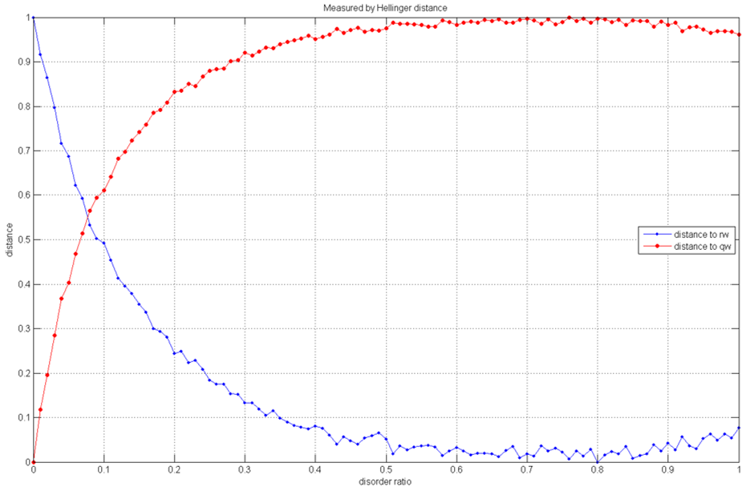
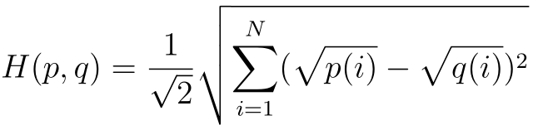
Variances and Hellinger distance
Distributions variance changing with disorder ratio.
Blue line is the mean of variances.
Green line is the variance of random walk.
Hellinger distances are measured:
Quantum walk V.S. quantum walk with disorders
Random walk V.S. quantum walk with disorders

Slide 9
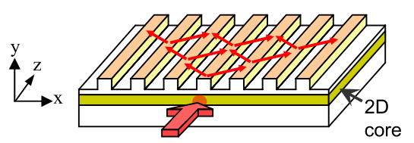
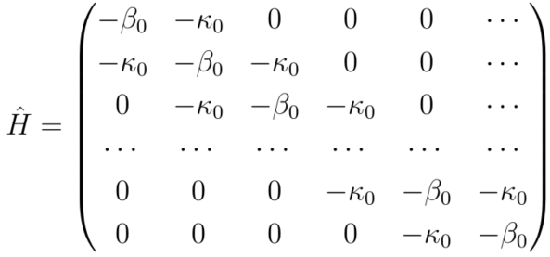
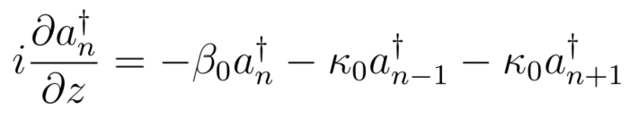
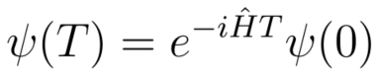
Continuous quantum walk with disorders
References:
10.1103/PhysRevLett.100.170506, 2008
10.1103/PhysRevLett.100.013906, 2008
10.1103/PhysRevLett.105.163905, 2010
10.1364/oe.19.013636, 2011
10.1103/PhysRevA.88.042334, 2013
10.1063/1.4871401, 2014
10.1103/PhysRevLett.115.133602, 2015

Slide 10
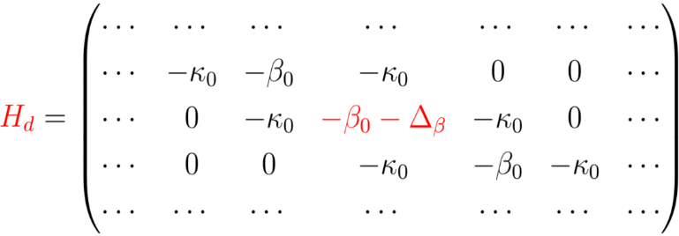
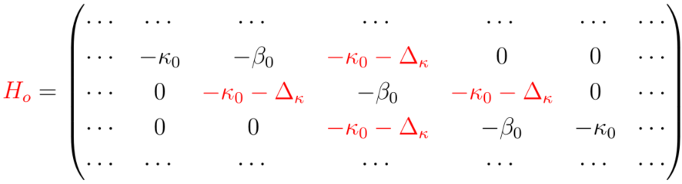
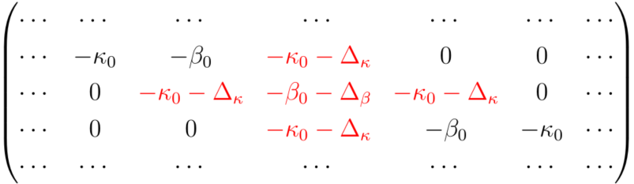

Classification of disorders
diagonal
static (position-dependent)
-2
-1
0
1
2
Localization
off-diagonal
-2
-1
0
1
2
mixed
disorder
dynamic
(time-dependent)
-2
-1
0
1
2
Decoherence?
fluctuating
(both position and time dependent)
Decoherence?
Notes:
Keywords:
In Anderson localization, probability is exponentially decay, thus Log(P(t)) is linear dependent in position.
In normal random walk, probability is not exponentially decay, Log(P(t)) is parabolic dependent in position.
Decoherence by unitary operations.
In the fluctuating model, dynamic disorders beat static disorder and result in decoherence.

Slide 11
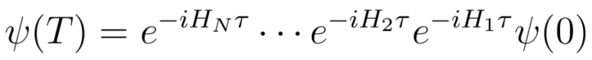
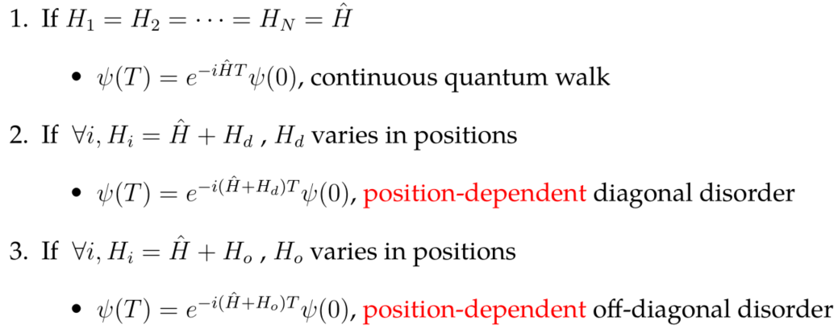
Formalization
Nτ
HN
...
...
...
...
3τ
H3
2τ
time
H2
τ
H1
0
-2
-1
0
1
2
position

Slide 12
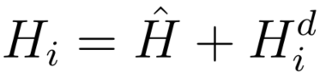
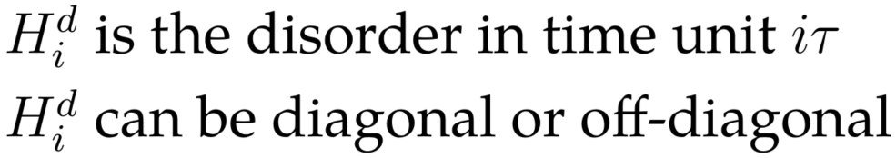
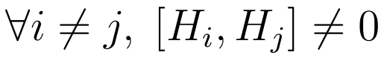
Time-dependent disorders
The disorders are randomly generated in each unit time, but is position independent
Nτ
HN
...
...
...
...
3τ
H3
2τ
time
H2
τ
H1
0
...
...
-2
-1
0
1
2
position
arXiv:1510.08652 formulizes time-dependent disorders in a continuous way.

Slide 13
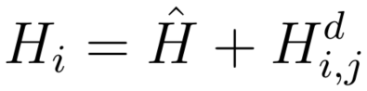
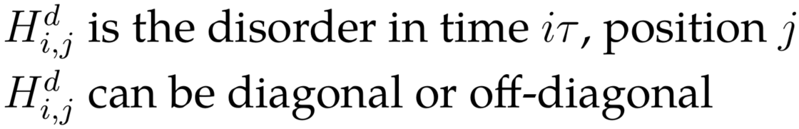
Fluctuating disorders
The disorders are randomly generated:
In each position and
In each unit time
Nτ
HN
...
...
...
...
3τ
H3
2τ
time
H2
τ
Decoherence?
H1
0
...
...
-2
-1
0
1
2
position

Slide 14
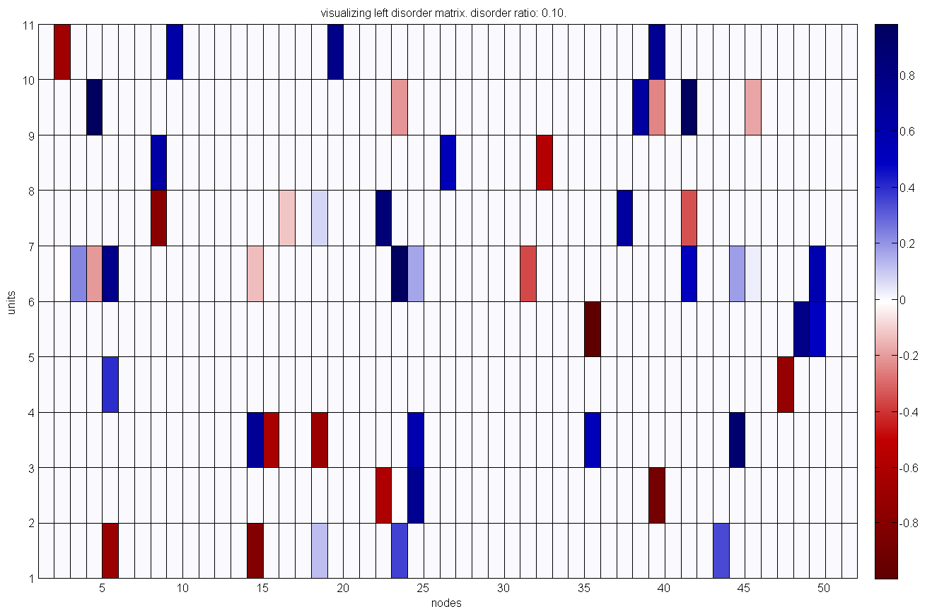
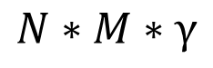
Fluctuating disorders visualization
Disorder ratio γ
Time units N
Nodes M
Number of disorders
$$N∗M∗γ$$
Diagonal disorders
Off-diagonal disorders
Notes:
Keywords:
Optical networks.
H is the Hadamard gate.
Coin operators with disorder are still unitary.

Slide 15
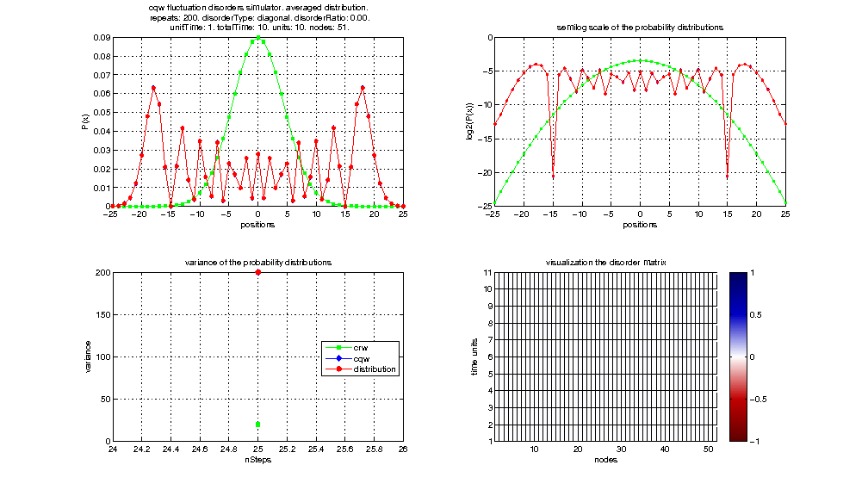
Diagonal fluctuating disorders

Slide 16
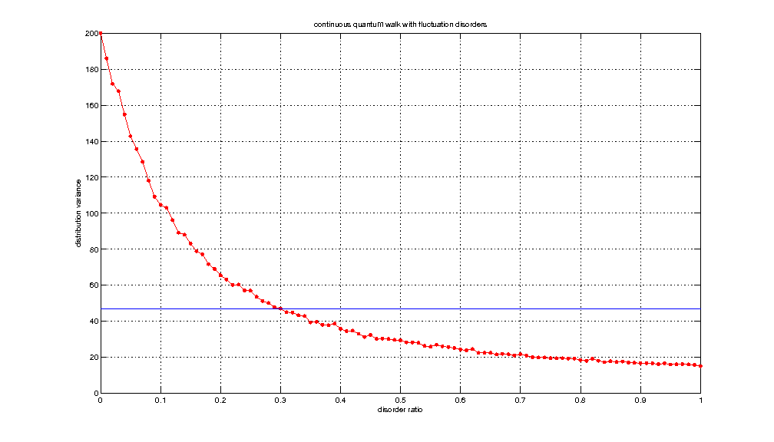
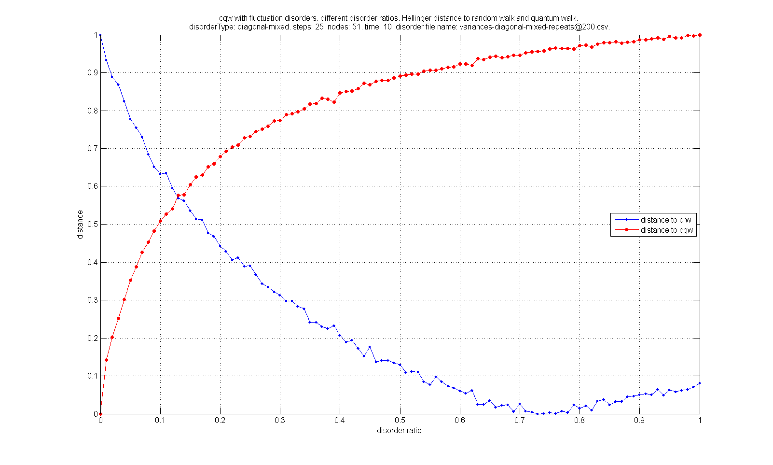
Diagonal: variances and Hellinger distance
Localization!
Distributions variance changing with disorder ratio.
Blue line is the mean of variances.
Hellinger distances are measured:
Quantum walk V.S. quantum walk with disorders
Random walk V.S. quantum walk with disorders

Slide 17

Off-diagonal fluctuating disorders

Slide 18
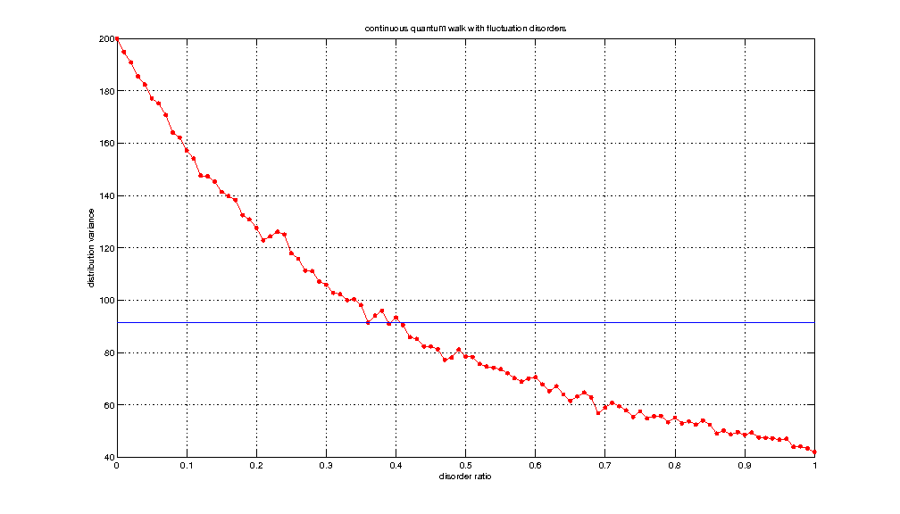
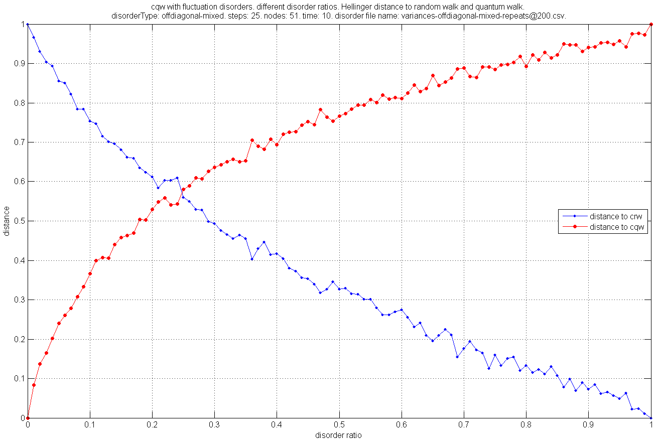
Off-diagonal: variances and Hellinger distance
Distributions variance changing with disorder ratio.
Blue line is the mean of variances.
Hellinger distances are measured:
Quantum walk V.S. quantum walk with disorders
Random walk V.S. quantum walk with disorders

Slide 19
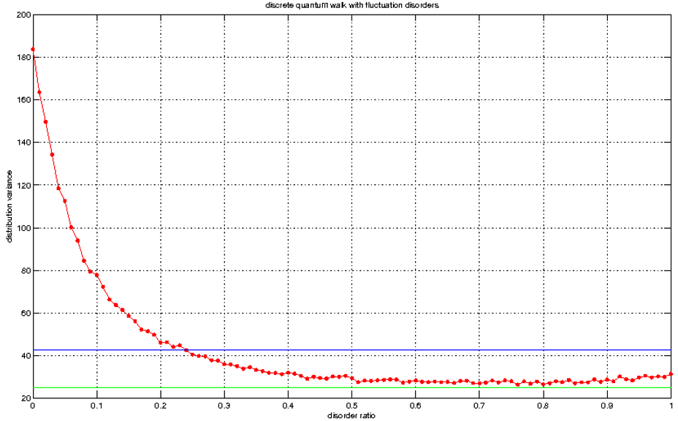
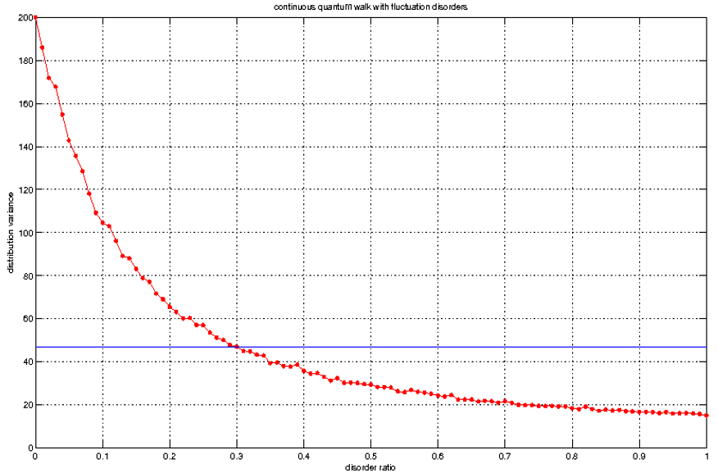
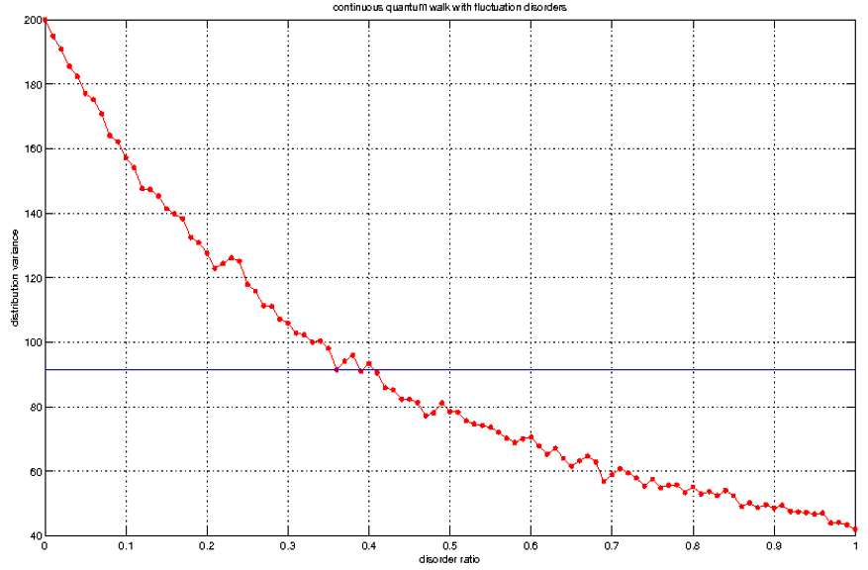
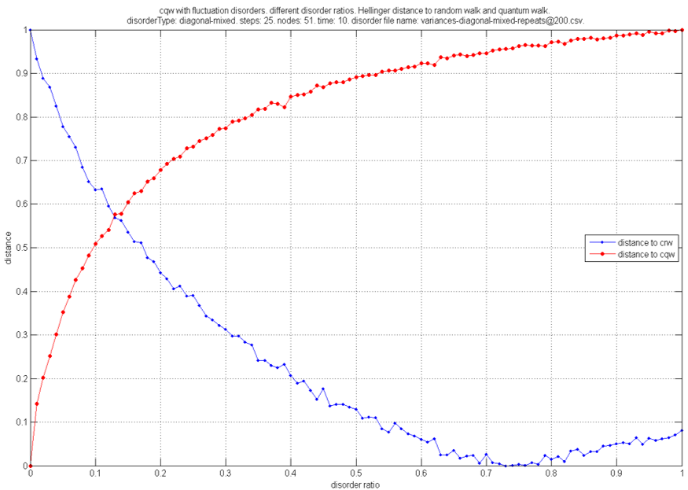
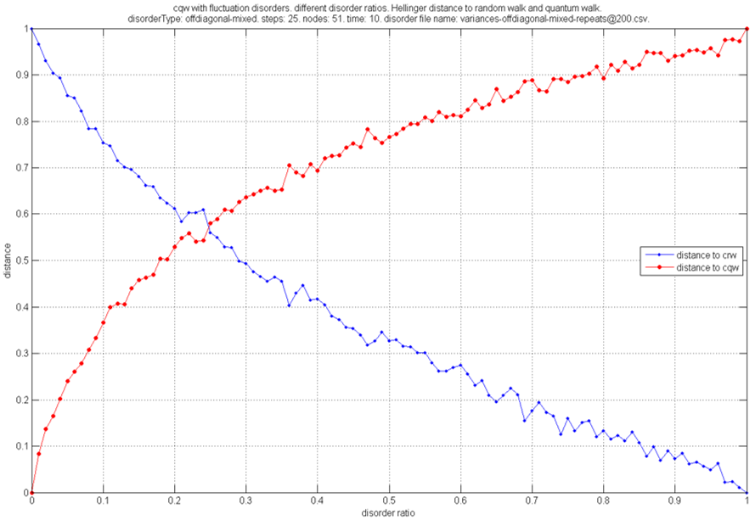
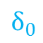
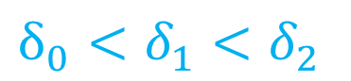
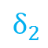
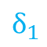
Comparisons
$$δ_{0}<δ_{1}<δ_{2}$$
Discrete decoherers faster than continuous
Diagonal decoherers faster than off-diagonal
$$δ_{0}$$
$$δ_{1}$$
$$δ_{2}$$
discrete
continuous diagonal
continuous off-diagonal

Slide 20
2. Three State Quantum Walk with Boundaries

Slide 21
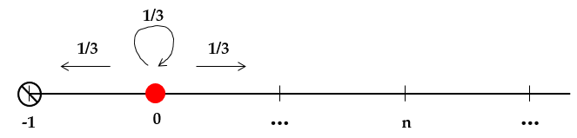
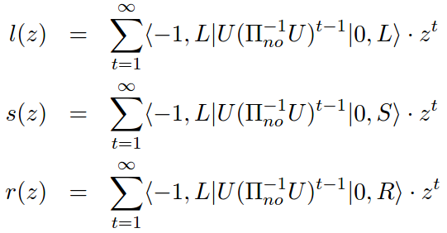
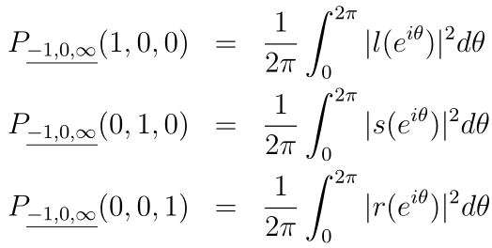
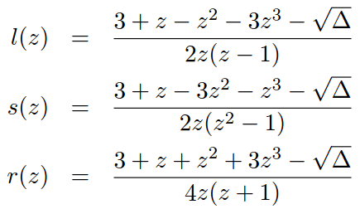
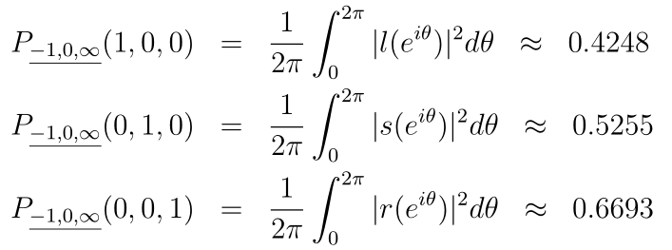
One boundary
Left boundary –1
An example: Grover walk

Slide 22






One boundary (cont.)
Arbitrary left boundary –M
Left boundary –M tends to infinity
function of l(z) evolves with z

Slide 23





Two boundaries
Left boundary –1, right boundary N
An example: Grover walk, left boundary -1, right boundary 1

Slide 24


Two boundaries (cont.)
Generating functions recurrences
We can calculate exit probability with arbitrary right boundary by solving the recurrences!
The case of N = 1

Slide 25





Localization of three state quantum walk
NOT Anderson localization
boundary in -1
boundary in -2
Coin state: [0;0;1]
Coin operator: Grover
Walking 400 steps
Oscillation between -1 and 0
results in localization
boundary in 1
boundary in 2

Slide 26
3. Propagation and Coupling Constants

Slide 27





Continuous quantum walk formulization
Hamiltonian in Farhi@PRA98
Hamiltonian in Wang@07
Two definitions for evolution Hamiltonian are the same.
The diagonal elements are to keep the Hamiltonian conservative.
No statement that “with some probability to jump, with remaining probability to stay”.

Slide 28


Continuous quantum walk and waveguide

Slide 29





K-sector triangle
coupling constant
propagation constant
k-sector triangle
In theoretical model
In experiment model

Slide 30
Thank you!

